Slide 1
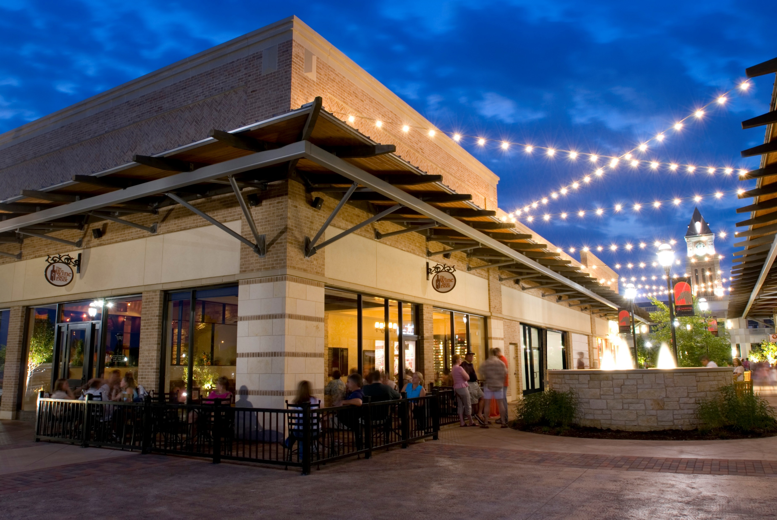
Vista Real Estate
Overview
La Centerra

Slide 2
Vista History
Founded in 1985, The Vista Companies is a full-service Houston-based real estate services group that specializes in the fields of real estate development, leasing, brokerage, and property management.
Vista Private Equity Group, which was founded in 2006, was formed to work alongside The Vista Companies in establishing attractive, risk adjusted returns in the core areas of traditional private equity and real estate development.
To date, Vista has been involved in the acquisition and/or development of 61 commercial properties with a market value of more than $530 Million.

Slide 3
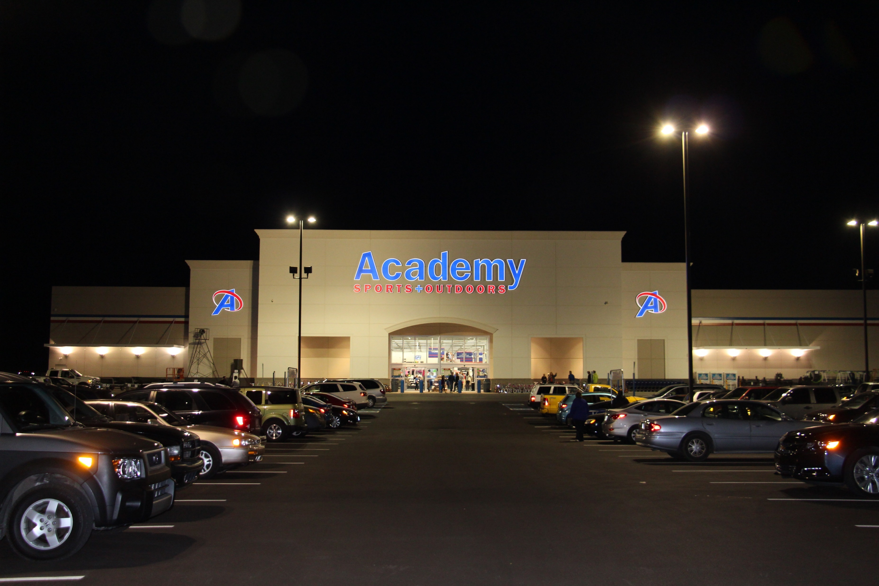
Investment Profile
Investment Size: $5 – 50 Million
Property Use:
  Retail
  Office
  Mixed-Use
Geography: Texas / Southeast U.S.
Vista Terre Haute

Slide 4
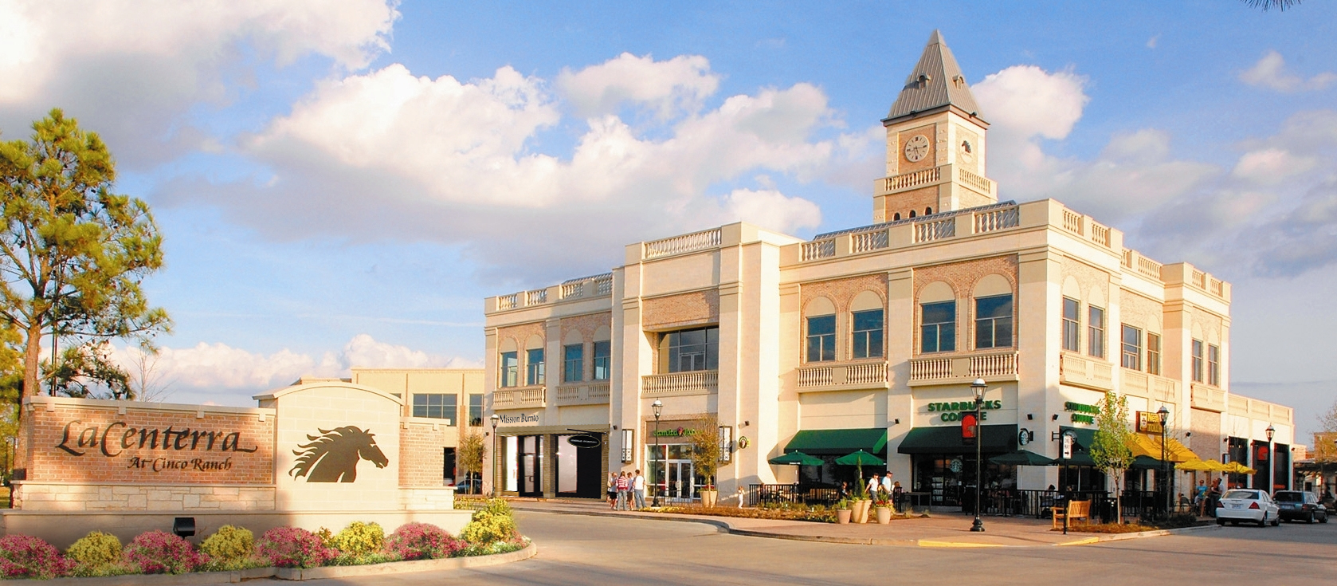
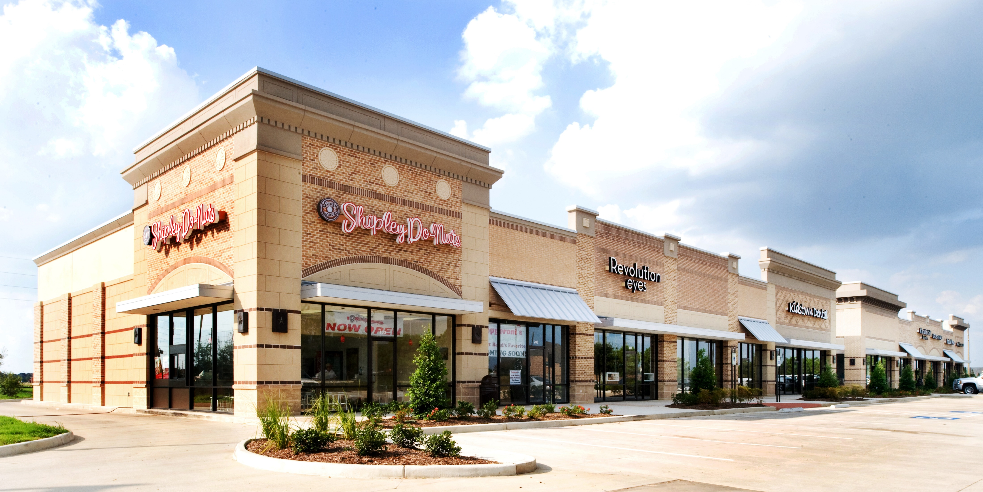
Vista Development Investments
La Centerra
Spring Green

Slide 5
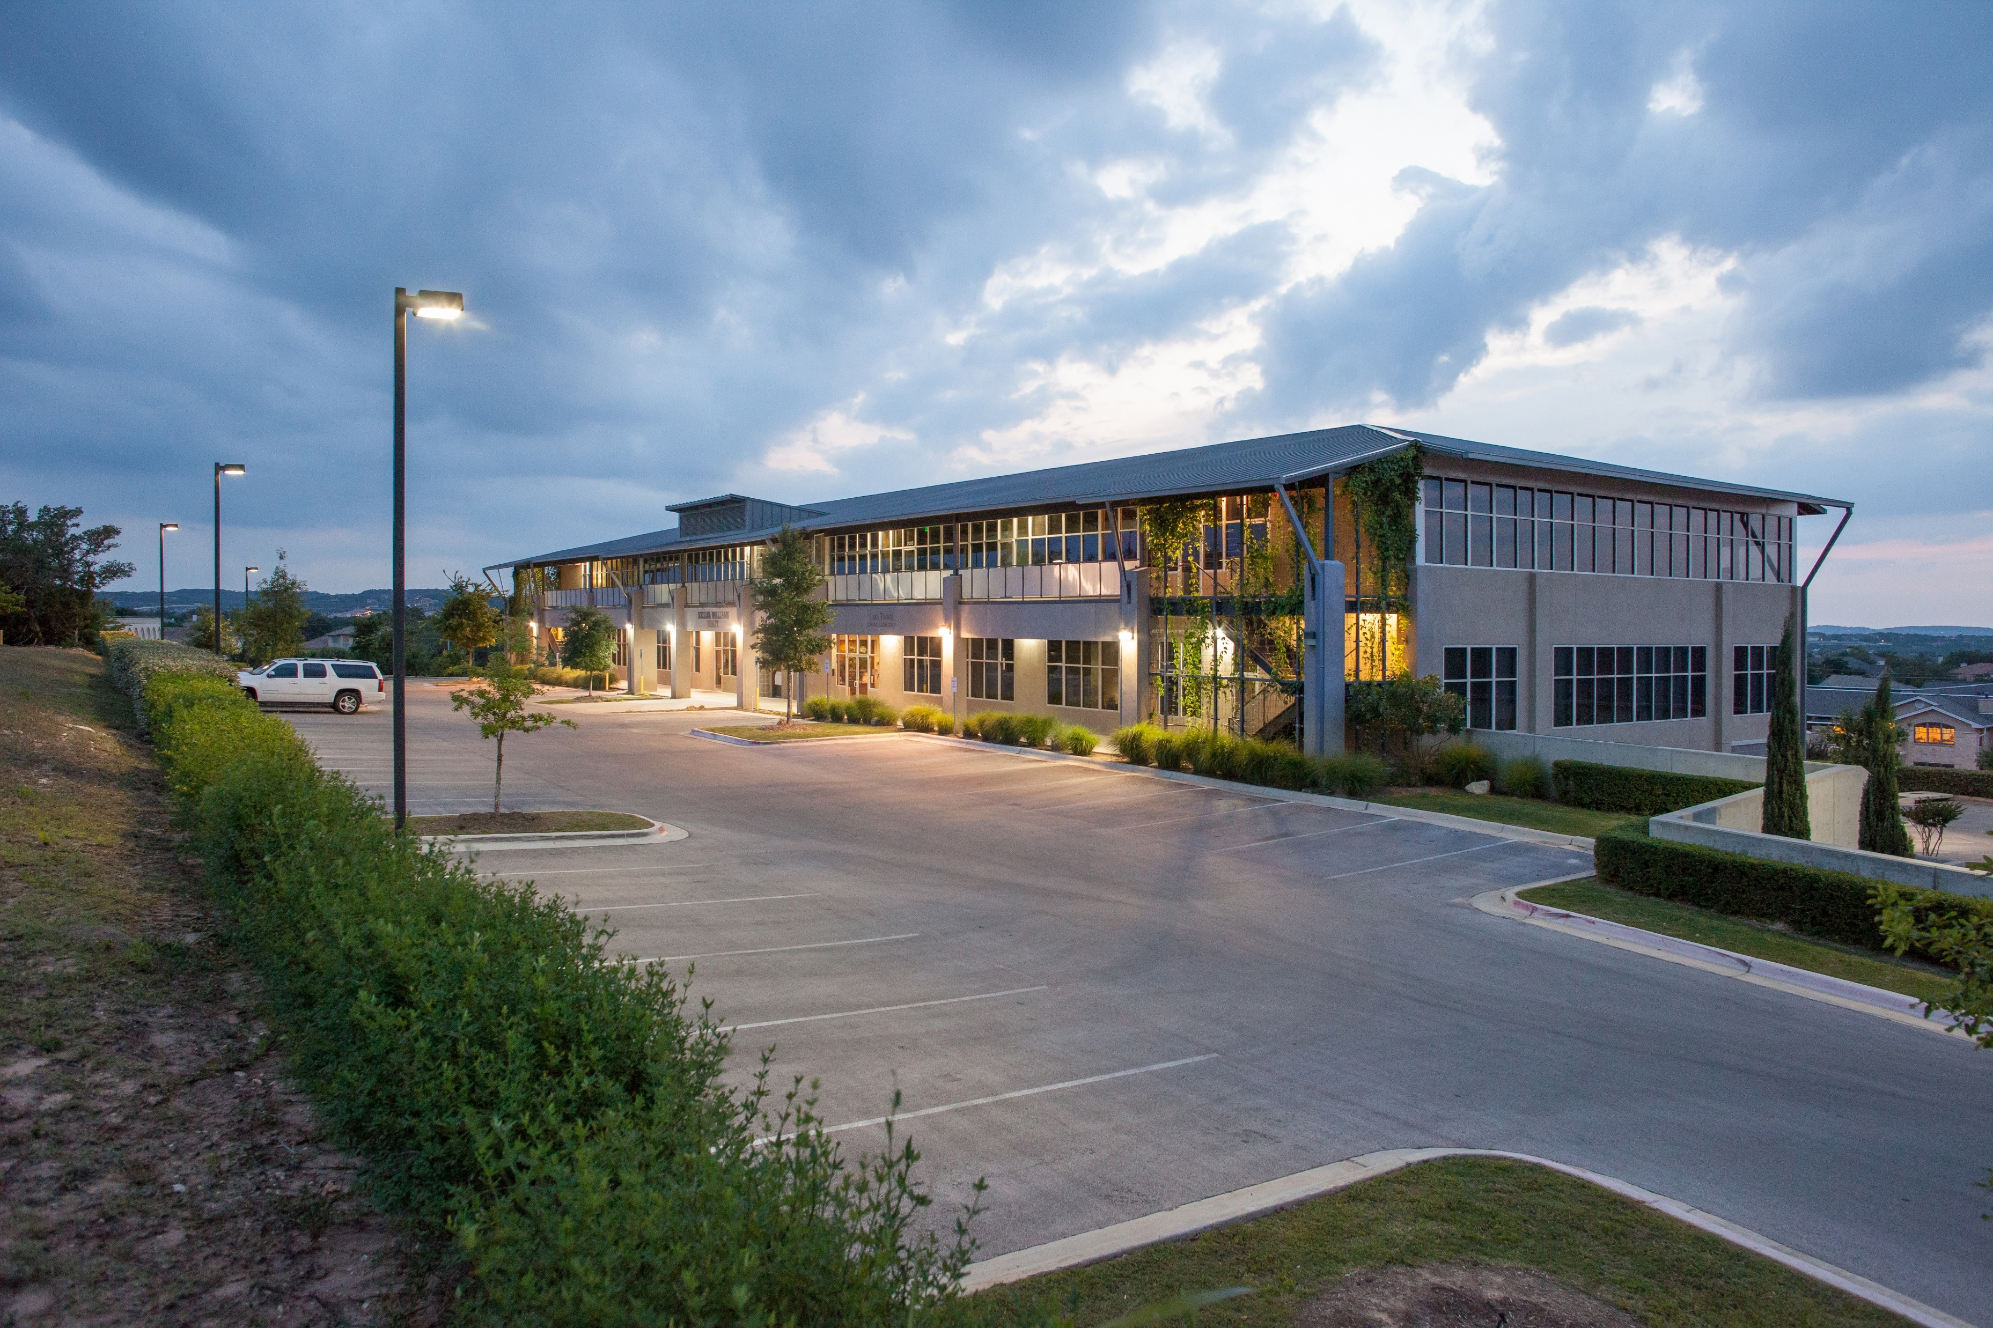
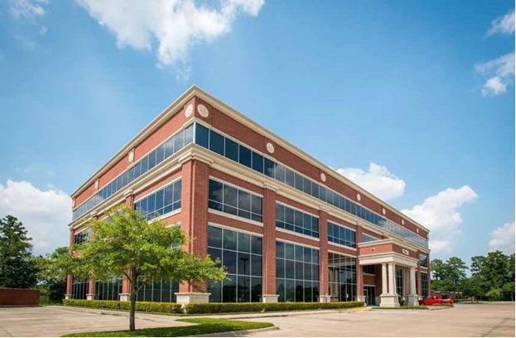
Vista Office Investments
Towers of Lakeway
Cypresswood

Slide 6
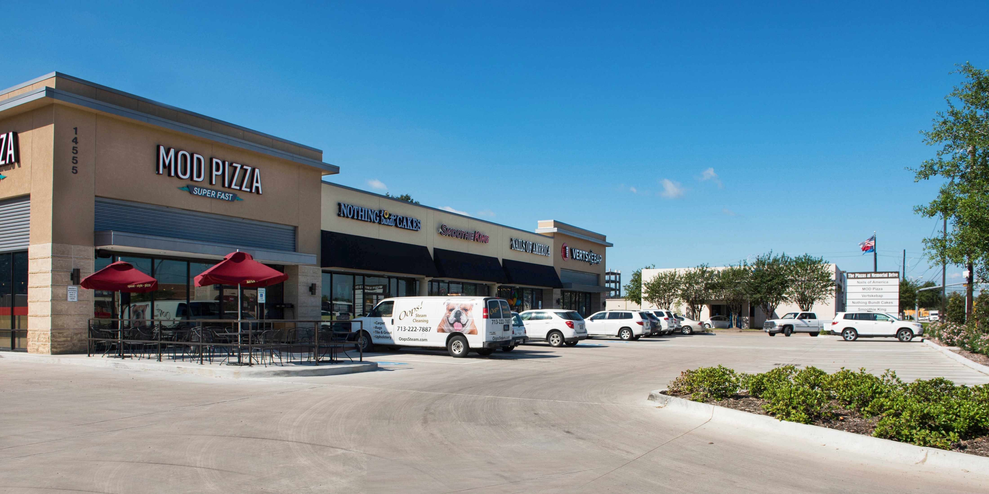
Vista Investment Returns
Realized
Average Holding Period: 5.5 Years
Average Cash-On-Cash Return: 2.5x
Average IRR: 19.3%
The Plazas at Memorial Drive

Slide 7
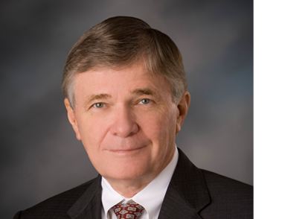
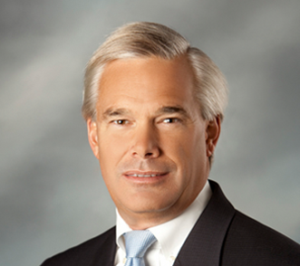
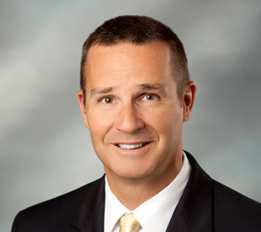
Vista Management Team
Woody Mann, Jr., President – Vista Equities Group: Woody currently serves as President of Vista Equities Group and Sr. Vice President of Vista Management Company (together, Vista Equities Group and Vista Management Company are referred to as “The Vista Companies” or as “Vista”). As a co-founder of The Vista Companies in 1985, he has been responsible for directing the growth of Vista from a small property management firm to one that is responsible for the development and acquisition of a retail and commercial property portfolio of over 1,300,000 sq. ft. with an estimated combined market value of over $160 Million.
Brent Mann, Founding Partner – Vista Private Equity Group: Brent is a founding Partner of Vista Private Equity Group (“VPEG”). Prior to co-founding VPEG during 2006, Brent served in a variety of executive/management capacities over the course of a 19-year career with Weingarten Realty Investors (NYSE: WRI), a Houston-based real estate investment trust with an equity market capitalization exceeding $2.5 billion. Brent served as Senior Vice President of New Business Development for Weingarten, where he held responsibility for leading new project development and merchant-build opportunities.
Greg Houghtaling, Founding Partner – Vista Private Equity Group: Greg is a founding Partner of the Vista Private Equity Group (“VPEG”) and co-manages the activities of Vista’s Private Equity Group. Prior to co-founding VPEG in 2006, Greg served as a Managing Director for 10 years with RSTW Partners, a Houston-based private equity firm which invested mezzanine and equity capital totaling $850 million through three institutional investment funds. At RSTW, Greg was responsible for managing the entire investment process on transactions that he led, including transaction sourcing, structuring, due diligence, negotiations/closings, post-closing management and coordinating investment exit scenarios.

Slide 8
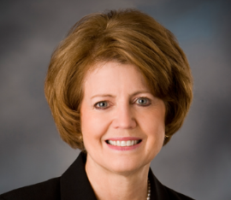
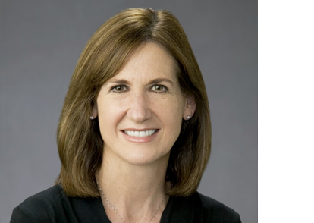
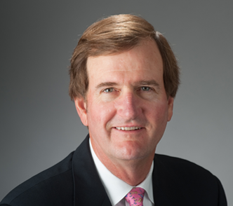
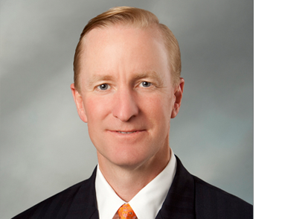
Vista Management Team
Cathie Mann, President – Vista Management Company: As a co-founder of Vista in 1985, Cathie brings a wealth of property management and leasing experience to the Vista team. As the president of Vista Management Company for twenty seven years, she and her property management, leasing, and maintenance staff oversee a portfolio of 1,200,000 square feet of shopping centers and office buildings, and mixed-use developments. In addition, she is responsible for final lease administration issues regarding language, definitions, and legal issues in all tenant leases.
Patty Bender, Partner – Vista Private Equity Group: Patty is a recently retired Executive Vice President with Weingarten Realty Investors and during her thirty-three year tenure, directed the Leasing, Marketing and Market Research departments. Ms. Bender was responsible for the net income of 300 shopping centers and directed all transactions in existing assets, re-developments and new developments. Her team’s responsibilities included anchor and shop tenant replacement, re-merchandising, and re-positioning assets to maximize cash flow.
Dennis Johnston, President – Vista Brokerage Services: Dennis is the founder of Vista Brokerage Services. Prior to founding Vista Brokerage Services, Dennis served as a Partner and President of McDade, Smith, Gould, Johnston and Mason, a Houston-based boutique commercial real estate firm. Involved in the sale of land to developers, end-users and investors, as well as leasing and investment sales, Dennis has negotiated over 300 transactions totaling approximately $600 million during the course of his career. He is a graduate of the University of Texas with a Masters degree in Business Administration

Slide 9
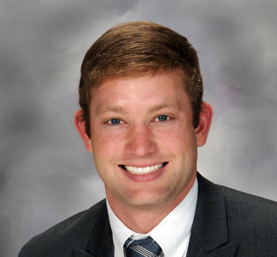
Vista Management Team
Kurt Keene, Founding Partner – Vista Private Equity Group: Kurt is a founding Partner of the Vista Private Equity Group (“VPEG”) and co-manages the activities of VPEG. Prior to co-founding VPEG in 2006, Kurt served as a Managing Director for 11 years with RSTW Partners, a Houston-based private equity firm which invested mezzanine and equity capital totaling $850 million through three institutional investment funds. At RSTW, Kurt was responsible for managing the entire investment process on transactions that he led, including transaction sourcing, structuring, due diligence, negotiations/closings, post-closing management and coordinating investment exit scenarios.
Matt Runkel, Associate – Vista Private Equity Group: Matt Runkel is responsible for analyzing and procuring new investment opportunities while providing support in the ongoing portfolio management process. Additionally, Matt assists with design oversight, construction coordination, investor relations and overall portfolio administration tasks. Prior to joining Vista Private Equity Group, Matt spent time in public accounting in Houston with PriceWaterhouse Coopers.

